Slide 1
St. Croix County Wisconsin
Broadband and Economic Development
Jill Hietpas, UWEX Regional Broadband Educator
Jill.hietpas@ces.uwex.edu
608-957-5539
Notes:
What is Broadband
Terms and Technologies
Broadband and Economic Influencers

Slide 2
What is Broadband?
Federal Communication Commission (FCC) definition (for residential service):
4 Mbps Down/1 Mbps Up 25 Mbps Down/3 Mbps Up
Alternative definition:
Connection that does not limit application (i.e. VoIP, web-based video streaming, future innovations?)
Notes:
Andy:
FCC Definition:
Proposed change for this year could be as high as 25 Mbps download
This last definition is the one that I have been using for more than ten years. It best describes what is needed and our needs are rapidly changing. We will come back to a brief discussion of the demand survey and broadband assessment tool that helps us determine what is needed.

Slide 3
Broadband=Many Different Flavors
Satellite
Cable
Fixed Wireless
DSL
Wi-Maxx
T1 Leased Line
Wireless
Wi-Fi
Wired
Fiber
Cell (3G, 4G, LTE)
Notes:
With broadband, it’s not about just one technology that is available to communities; broadband comes in many different “flavors” and these different technologies together and alone to provide the broadband speeds, or bandwidth, needed to perform modern applications to….

Slide 4
What Do We Mean Broadband?
Bit
The smallest unit of measure for data; equals either a or . Broadband speed (aka bandwidth) is measured in Bits Per Second (bps).
Byte
Eight bits = one byte; data is measured in bytes
Bandwidth
The amount of data that can travel in a given time (dependent on the size of the “pipe” data travels)
1
0
1
0
1
1
0
0
1
1

Slide 5
Speed Matters….
Files/Data (Megabytes)
Technology (Data Pipe)
Dial-up+ (56 Kbps):
1 day, 10 hrs, 44 min
T1/DSL (1.54 Mbps):
1 Hour, 15 min
Cable (10 Mbps ):
11 min, 44 sec
Fiber (1 Gbps):
7 sec
http://www.numion.com/calculators/time.html
Notes:
Andy:
So why does speed matter?
Two things to know: The Data Pipe or technology measures the speed or “bandwidth” in megabits per second. As you can see in this example with wired technologies, the larger the pipe/faster the speed, the quicker a file will download to your computer/device. File sizes (measured in Megabytes) vary pending the work you do--visiting (or downloading) a webpage is a relatively small file size; viewing or streaming a video which is a larger file size requires more bandwidth or a bigger pipe—in this example you can clearly see fiber is a bigger pipe and will download a 835 MB file in seconds versus days with a dial-up connection.
So why does this matter? As the internet and innovations evolved, so do the bandwidth needs and demand—streaming videos and large data files is commonplace for education, telemedicine, etc.

Slide 6
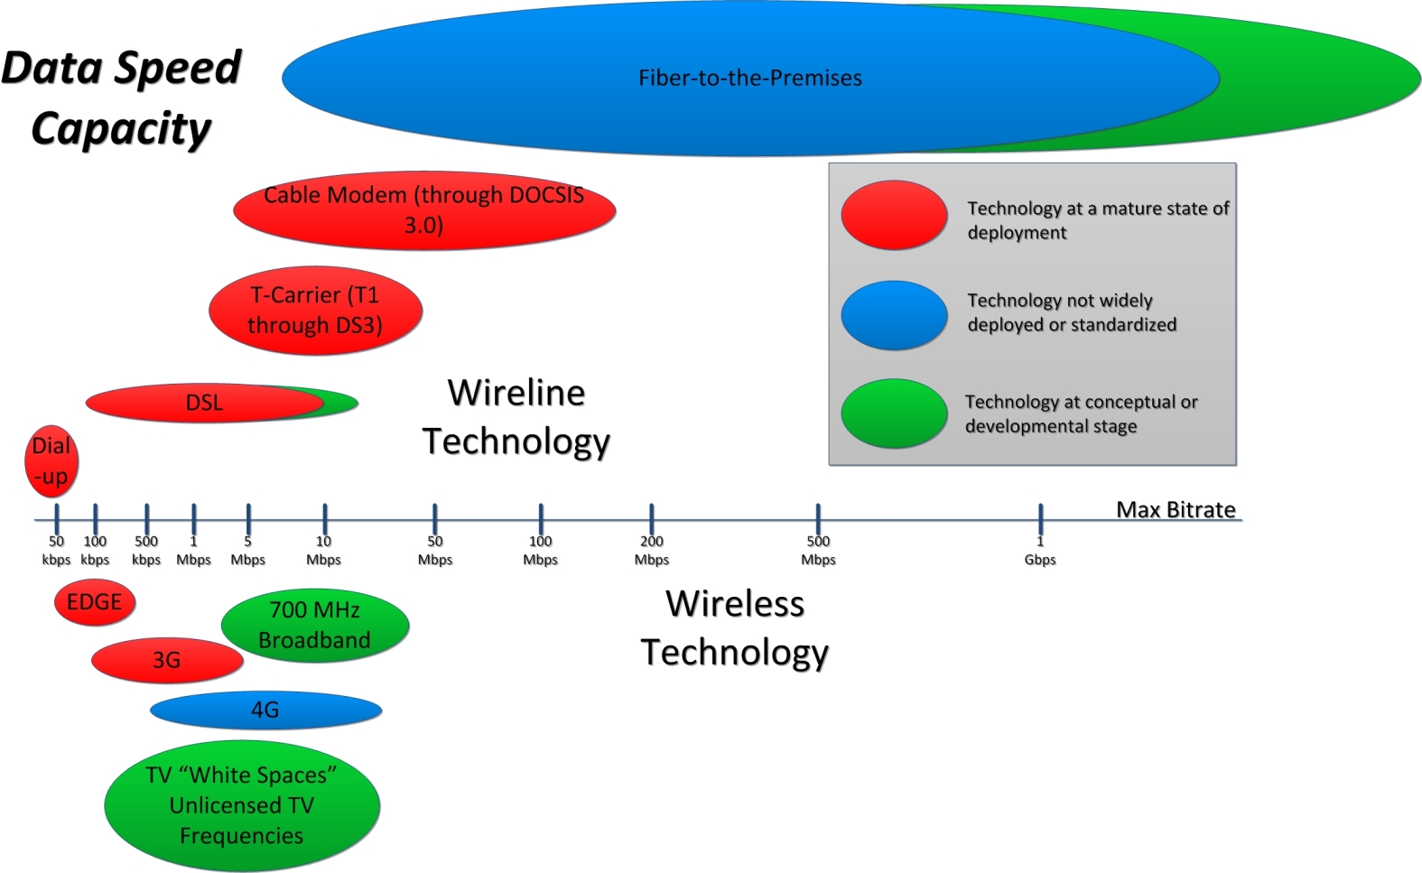
Source: CTC Technology & Engineering, 2013

Slide 7
Popular Wired Technologies
Fiber-optic cable
Performance: High
Reliability: High
Cost: High
Maintenance: Low
Digital Subscriber Line
Performance: Moderate
Reliability: Moderate/High
Cost: Low (Compared to Fiber)
Maintenance: Moderate
Cable
Performance: High
Reliability: Moderate
Cost: Varies (Whether new or existing HFC)
Maintenance: Moderate

Slide 8
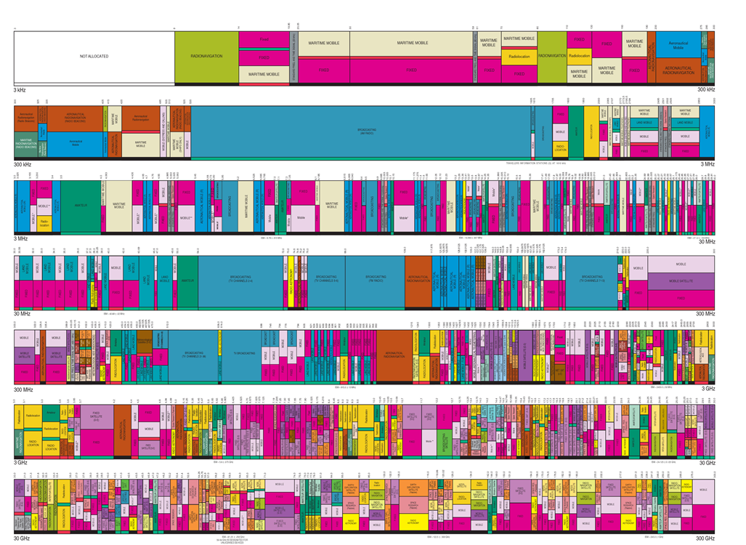
Common Wireless Technologies
Wi-Fi
Performance: Varies, Limited Range
Reliability: High
Cost: Low
Maintenance: Low
Wireless
3G, 4G, LTE
Performance: Moderate to Very High
Reliability: Moderate
Cost: Low/Moderate
Comments: 4G LTE not available everywhere, limited range, and data limits
Wi-Max
Performance: Moderate/High
Reliability: Moderate
Cost: Moderate
Comments: Commonly Used by WISPs, Backhaul, or Redundant Service and May Require Licensing

Slide 9
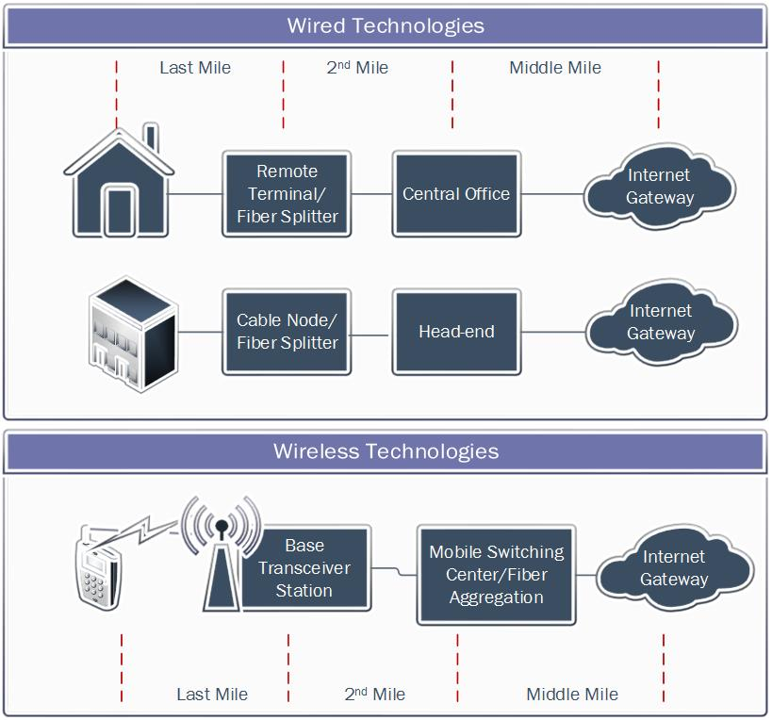
Wired or Wireless?
“Ya got to have em both…”
Notes:
Jill:
Defy the myth: Wireless does not stand alone—it can’t take over the world and be the only solution; in other words, you can’t have wireless without a wired connection. Ya need em both!
So, How Did We get and how do we evolve so all communities are connected?

Slide 10
Broadband & Economic Influencers
Access
Adoption
Utilization
Notes:
What we know based on state and national broadband data
FCC-477 Subscription Data
Bandwidth Assessment Data

Slide 11
Broadband and Impacts on Economic Development
Access, Adoption, and Utilization are not the same concepts
It’s NOT just about investing in infrastructure, but driving utilization
A Broadband Lifecycle Approach
Bolsters Rural Economies
http://blandinfoundation.org/_uls/resources/SNG--ROI_from_Broadband_Infrastructure_and_Utilization--01-31-14.pdf
Notes:
Access, Adoption, and Utilization are not the same concepts - Just because people have access to broadband infrastructure does not mean people are connected to the network; just because people have adopted broadband does not mean they are using the available Internet-enabled solutions that increases their productivity and business competitiveness.
• It is not just about investing in broadband infrastructure, but driving utilization – Not only is driving utilization critical to network sustainability, it is foundational to realizing full economic and community benefits from the network investment.
• Bolstering rural economies – Broadband is essential infrastructure for effective participation in the economy for urban and rural areas alike, with adoption driven by personalizing the value of broadband to individual businesses, organizations and households.
• A broadband lifecycle approach – Maximum returns on broadband investments require looking beyond the supply-side to make sure that each step of the process is addressed with a holistic planning approach. This is accomplished by building access, encouraging adoption, and tracking utilization, focusing on the demand-side of broadband and understanding how individual businesses, organizations and households are using the network.

Slide 12
Economic Impacts of Broadband
Attract entrepreneurs, employees and customers
Enable new products and services
Create products and services in new ways
Expand freedom to live, work and play where desired
Interact with customers and venders anywhere/anytime
GLOBAL

Slide 13
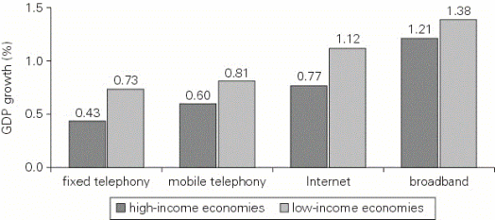
Growth Effects of GDP
http://broadbandtoolkit.org/1.3
Notes:
2012 World Bank study:
Gross Domestic Product
Increased use of broadband networks and services has been found to produce positive outcomes that reverberate throughout a country, particularly involving GDP.
low-income and middle-income countries experienced “about a 1.38 percentage point increase in GDP for each 10 percent increase in [broadband] penetration” between 2000 and 2006.*
the development impact of broadband on emerging economies is greater than for high-income countries, which “enjoyed a 1.21 percentage point increase in per capita GDP growth” per 10 percent increase in broadband penetration.*
broadband has a potentially higher growth effect than other ICTs (info and communication technologies), including wireline telephony, mobile telephony and the Internet, as shown in Figure 1.2.

Slide 14
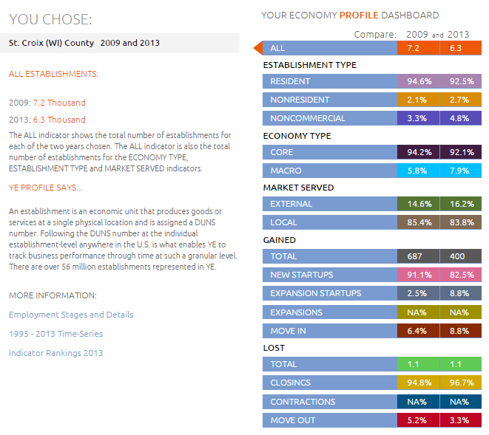
St. Croix County (http://ye.org)

Slide 15
St. Croix County (http://ye.org)
Establishments
Jobs
Notes:
Stage 1

Slide 16
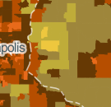
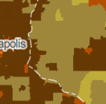
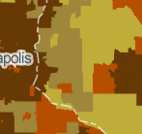
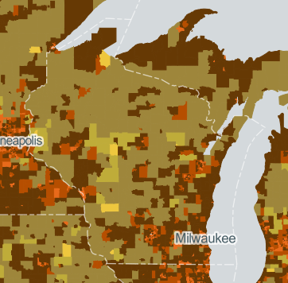
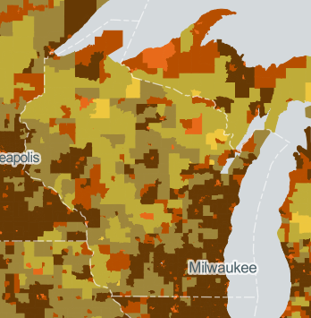
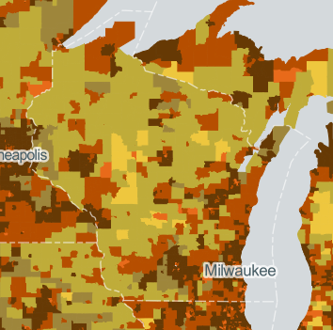
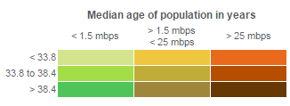
Demographics that Influence Broadband
http://www.broadbandmap.gov/demographics
Age
Household Income
Education
Notes:
This map displays availability of higher broadband speeds across demographic characteristics (density, age, income or education).

Slide 17
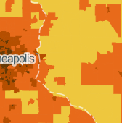
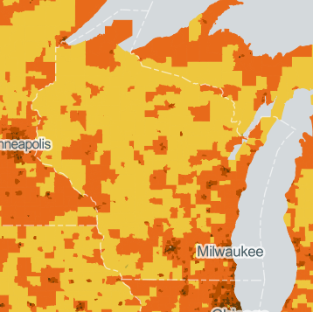
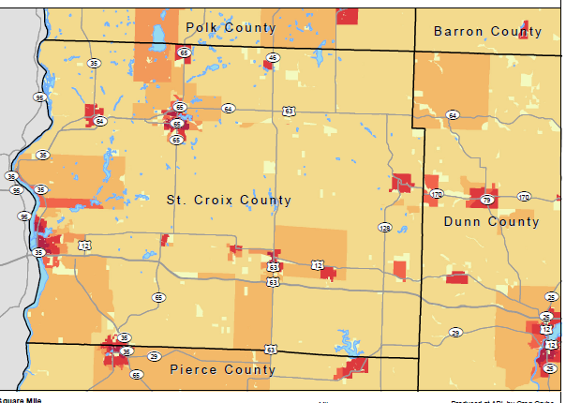
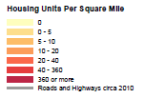
Population/Household Density
http://www.apl.wisc.edu/resource_profiles/hu_density/clark_county.pdf
Notes:
Population Density and housing density may be used for different purposes. A couple things to note, areas in which population density and housing is sparse are consistent with those considered “broadband eligible” for PSC Expansion grants (2014). Another topic to consider for broadband access in these locations are second homes and the impact broadband could potentially have on a community if folks stay in their home longer.
56% of households say they would definitely/likely relocate if broadband was not available
32% of households work from home or have a home-based business

Slide 18
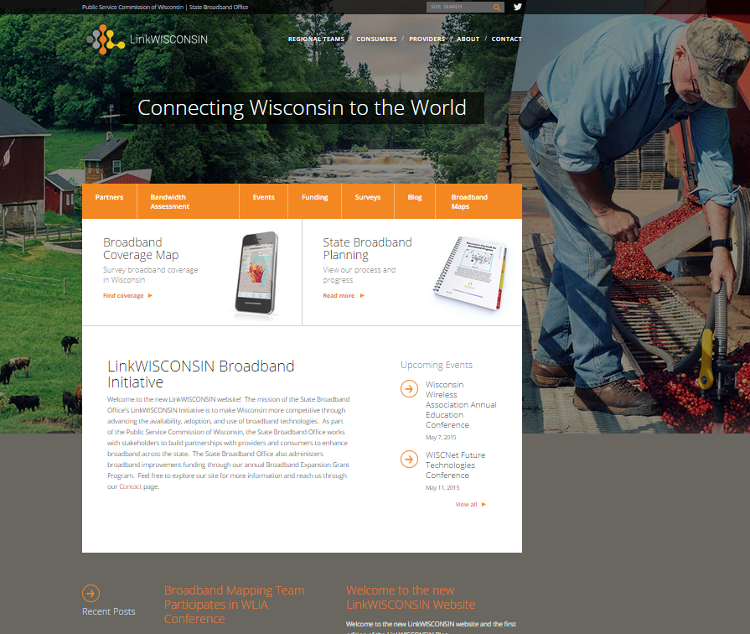
Broadband Infrastructure (St. Croix County)
http://www.link.wisconsin.gov/

Slide 19
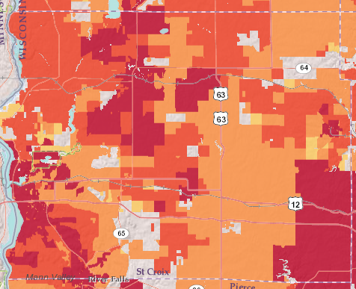
LinkWISCONSIN Maps
Maximum Download Speed, Fixed Connections
Source: http://www.broadbandmap.wisconsin.gov/. Darkest red map on the speed maps is considered broadband per the January 2015 FCC broadband definition. Note: Maximum Advertised Speed reported by at least one listed provider, some providers listed may not offer service at this speed and therefor validation for an address is required. (Data from June, 2014)
Notes:
Fixed download speeds include both wired and fixed wireless technologies.

Slide 20
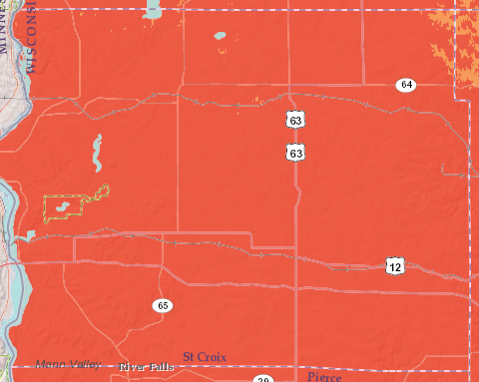
LinkWISCONSIN Maps
Maximum Download Advertised Speed, Mobile
Source: http://www.broadbandmap.wisconsin.gov/. Darkest red map on the speed maps is considered broadband per the January 2015 FCC broadband definition. Note: Maximum Advertised Speed reported by at least one listed provider, some providers listed may not offer service at this speed and therefor validation for an address is required. (Data from June, 2014)
Notes:
LinkWISCONSIN Maps

Slide 21
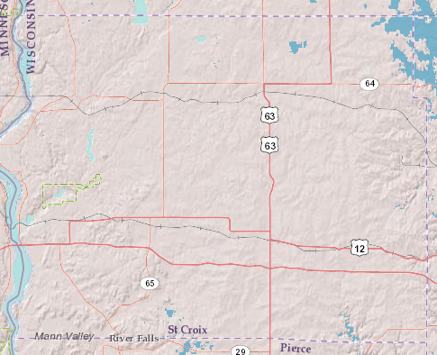
Broadband Expansion Grant (Eligible Areas in St. Croix County)

Slide 22
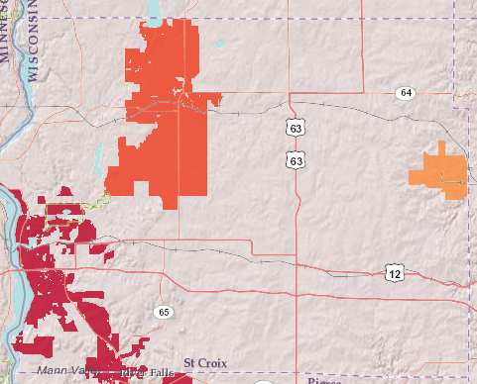
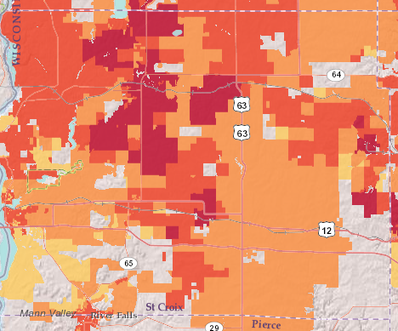
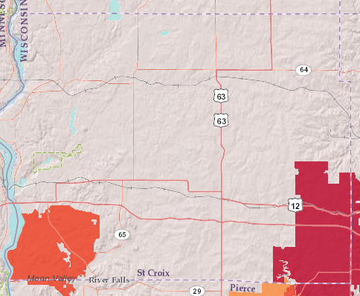
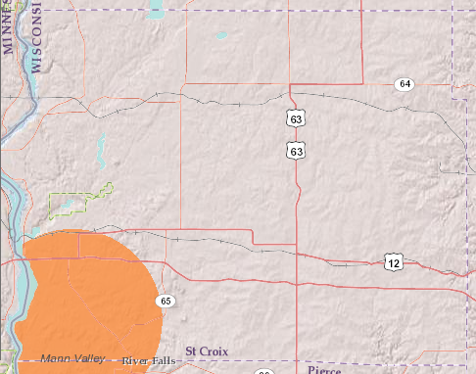
Technology Coverage (in St. Croix)
Cable Modem Coverage
DSL Coverage
Fiber to the Premise
Fixed Wireless Coverage

Slide 23
Potential Partners?
Internet Service Providers
Last Mile
Middle Mile
Anchor Institutions
Hospitals
Schools
Libraries
Government Agencies (City/County)
DOT/DNR and Existing Infrastructure
Other?

Slide 24
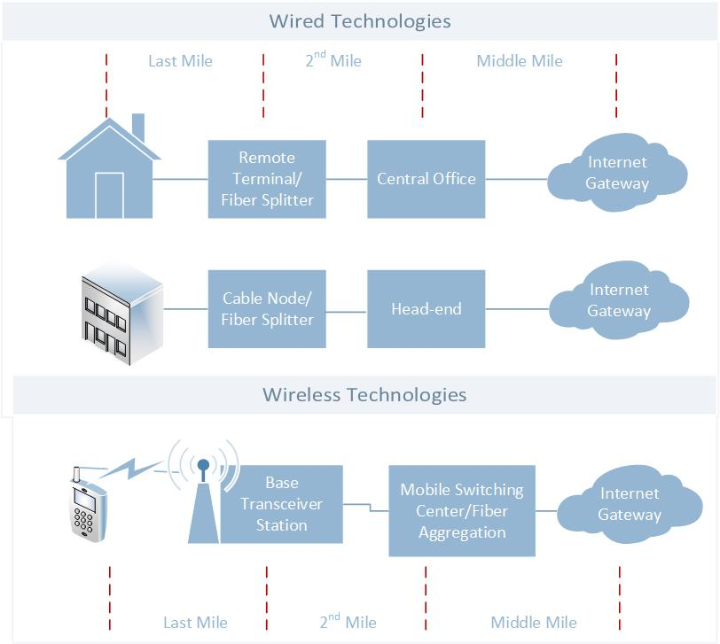
Access and Infrastructure
Who are your Last Mile and Middle Mile Providers?
Notes:
Who are the Middle Mile Providers and/or Partners?

Slide 25
Internet Service Providers (St. Croix County)
PROVIDER NAME | TECHNOLOGY
Amery Telecom | Asymmetric xDSL
AT&T Mobility LLC | Mobile Wireless
Baldwin Telecom, Inc. | Asymmetric xDSL
Baldwin Telecom, Inc. | Optical Carrier/Fiber to the End User
CenturyLink, Inc. | Asymmetric xDSL
Clear Lake Telephone Company LLC | Asymmetric xDSL
Comcast Cable Communications, LLC | Cable Modem - DOCSIS 3.0
CTC Telecom | Terrestrial Mobile Wireless
Frontier Communications of St Croix, LLC | Asymmetric xDSL
Nextera Wireless, LLC | Terrestrial Fixed Wireless - Licensed
Nextgen Communications, LLC | Cable Modem - Other
Northwest Community Communications | Cable Modem - DOCSIS 3.0
Somerset Telephone Company | Asymmetric xDSL
Spring Valley Telephone Company, Inc. | Optical Carrier/Fiber to the End User
Sprint Corporation | Terrestrial Mobile Wireless
T-Mobile USA, Inc. | Terrestrial Mobile Wireless
Verizon Wireless | Terrestrial Mobile Wireless
West Wisconsin Telcom Cooperative | Optical Carrier/Fiber to the End User
Wisconsin Bell, Inc | Asymmetric xDSL
Notes:
PROVIDER
URL
TECHNOLOGY TYPE
Fixed Wireless
Mobile Wireless
DSL
CABLE
FIBER
AirRunner Networks, LLC
http://www.airrun.net/
X
AT&T Mobility LLC
www.wireless.att.com
X
Badger Telecom, LLC
http://www.tdstelecom.com/
X
X
CellCom
http://www.cellcom.com/
X
Central State Telephone Company, LLC
http://www.tdstelecom.com/
X
CenturyLink, Inc.
http://www.centurylink.com/
X
Charter Communications
www.charter.com
X
Country Wireless, LLC
http://www.countrywireless.com/
X
Frontier North, Inc
http://frontier.com/
X
Midway Telephone Company, LLC
http://www.tdstelecom.com/
X
Packerland Broadband
http://www.packerlandbroadband.com/
X
Sprint Corporation
http://www.sprint.com/
X
UsCellular
www.uscellular.com
X
Verizon Wireless
http://www.verizonwireless.com/
X
Western Wisconsin Communication
http://www2.tcc.coop
x
Wisconsin RSA #7
http://www.lakecountrymobility.com/
x
Additional Provider(s) Within 10 Miles of Clark County
Tri-County Communications Cooperative
http://www2.tcc.coop
X
Wisconsin RS#7 (Lake County Mobility) operates as a subsidiary of ATT Mobility, LLC

Slide 26
Internet Service Providers (Within 10 Miles)
PROVIDER | TECHNOLOGY
24-7 Telcom, Inc. | Terrestrial Fixed Wireless - Licensed
Amery Telecom | Asymmetric xDSL
AT&T Mobility LLC | Terrestrial Mobile Wireless
Baldwin Telecom, Inc. | Asymmetric xDSL
Baldwin Telecom, Inc. | Optical Carrier/Fiber to the End User
CenturyLink, Inc. | Asymmetric xDSL
Charter Communications | Cable Modem - DOCSIS 3.0
Chibardun Telephone Cooperative | Asymmetric xDSL
Clear Lake Telephone Company LLC | Asymmetric xDSL
Comcast Cable Communications, LLC | Cable Modem - DOCSIS 3.0
CTC Telecom | Terrestrial Mobile Wireless
Frontier Communications of St Croix, LLC | Asymmetric xDSL
Midcontinent Communications | Cable Modem - DOCSIS 3.0
Nextera Wireless, LLC | Terrestrial Fixed Wireless - Licensed
Nextgen Communications, LLC | Cable Modem - Other
Northwest Community Communications | Cable Modem - DOCSIS 3.0
Somerset Telephone Company | Asymmetric xDSL
Spring Valley Telephone Company, Inc. | Optical Carrier/Fiber to the End User
Sprint Corporation | Terrestrial Mobile Wireless
T-Mobile USA, Inc. | Terrestrial Mobile Wireless
Verizon Wireless | Terrestrial Mobile Wireless
West Wisconsin Telcom Cooperative | Optical Carrier/Fiber to the End User
Wisconsin Bell, Inc | Asymmetric xDSL

Slide 27
Internet Service Providers (Adjacent Counties)
PROVIDER | TECHNOLOGY
24-7 Telcom, Inc. | Asymmetric xDSL
24-7 Telcom, Inc. | Terrestrial Fixed Wireless - Licensed
Amery Telecom | Asymmetric xDSL
AT&T Mobility LLC | Terrestrial Mobile Wireless
Baldwin Telecom, Inc. | Asymmetric xDSL
Baldwin Telecom, Inc. | Optical Carrier/Fiber to the End User
Bloomer Telephone Company | Asymmetric xDSL
Bloomer Telephone Company | Optical Carrier/Fiber to the End User
CenturyLink, Inc. | Asymmetric xDSL
Charter Communications | Cable Modem - DOCSIS 3.0
Chibardun Telephone Cooperative | Asymmetric xDSL
Chippewa Valley Cable, Inc. | Cable Modem - Other
Citizens Telephone Cooperative, Inc. | Optical Carrier/Fiber to the End User
Clear Lake Telephone Company LLC | Asymmetric xDSL
Clearwire | Terrestrial Mobile Wireless
Comcast Cable Communications, LLC | Cable Modem - DOCSIS 3.0
CTC Telecom | Asymmetric xDSL
CTC Telecom | Terrestrial Mobile Wireless
Farmers Independent Telephone Company | Asymmetric xDSL
Farmers Independent Telephone Company | Optical Carrier/Fiber to the End User
Frontier Communications of Mondovi, LLC | Asymmetric xDSL
Frontier Communications of St Croix, LLC | Asymmetric xDSL

Slide 28
Internet Service Providers (Adjacent Counties)
PROVIDER | TECHNOLOGY
Hager Telecom, Inc. | Asymmetric xDSL
Hager Telecom, Inc. | Cable Modem - DOCSIS 3.0
Indianhead Telephone Company | Asymmetric xDSL
Lakeland Communications Group, LLC | Asymmetric xDSL
Lakeland Communications Group, LLC | Cable Modem - DOCSIS 3.0
Lakeland Communications Group, LLC | Optical Carrier/Fiber to the End User
Midcontinent Communications | Cable Modem - DOCSIS 3.0
Nelson Telephone Cooperative | Asymmetric xDSL
Nextera Wireless, LLC | Terrestrial Fixed Wireless - Licensed
Nextgen Communications, LLC | Cable Modem - Other
Northwest Community Communications | Cable Modem - DOCSIS 3.0
Siren Telephone Company, Inc. | Asymmetric xDSL
Somerset Telephone Company | Asymmetric xDSL
Spring Valley Telephone Company, Inc. | Optical Carrier/Fiber to the End User
Sprint Corporation | Terrestrial Mobile Wireless
Starwire Technologies | Terrestrial Fixed Wireless - Unlicensed
T-Mobile USA, Inc. | Terrestrial Mobile Wireless
Verizon Wireless | Terrestrial Mobile Wireless
West Wisconsin Telcom Cooperative | Optical Carrier/Fiber to the End User
Wisconsin Bell, Inc | Asymmetric xDSL

Slide 29
Anchor Institutions
HERITAGE CENTER | NEW RICHMOND
C.A. FRIDAY MEMORIAL LIBRARY (NEW RICHMOND) | NEW RICHMOND
CARLETON A. FRIDAY MEMORIAL LIBRARY | NEW RICHMOND
RIVER FALLS HIGH SCHOOL | RIVER FALL
RIVER FALLS FIRE DEPT | RIVER FALLS
MEYER MIDDLE | RIVER FALLS
WESTSIDE ELEMENTARY | RIVER FALLS
ROCKY BRANCH ELEMENTARY | RIVER FALLS
RENAISSANCE CHARTER ACAD | RIVER FALLS
GREENWOOD ELEMENTARY-RIVER FALLS SD | RIVER FALLS
CHIPPEWA VALLEY TECHNICAL COLLEGE | RIVER FALLS
UNIVERSITY OF WISCONSIN-RIVER FALLS | RIVER FALLS
RIVER FALLS PUBLIC MONTESSORI | RIVER FALLS

Slide 30
Anchor Institutions
RIVER FALLS PUBLIC LIBRARY | RIVER FALLS
RIVER FALLS AREA HOSPITAL | RIVER FALLS
RIVER FALLS SCHOOL DISTRICT | RIVER FALLS
INDIAN HILLS SCHOOL | RIVER HILLS
SAINT CROIX CENTRAL ELEMENTARY | ROBERTS
HAZEL MACKIN COMM LIBRARY (ROBERTS) | ROBERTS
ROBERTS-WARREN FIRE DEPT | ROBERTS
SOMERSET FIRE/RESCUE | SOMERSET
SOMERSET PUBLIC LIBRARY | SOMERSET
SOMERSET MIDDLE | SOMERSET
SOMERSET ELEMENTARY | SOMERSET
SOMERSET HIGH SCHOOL | SOMERSET
WOODVILLE COMM LIBRARY | WOODVILLE
VIKING MIDDLE | WOODVILLE

Slide 31
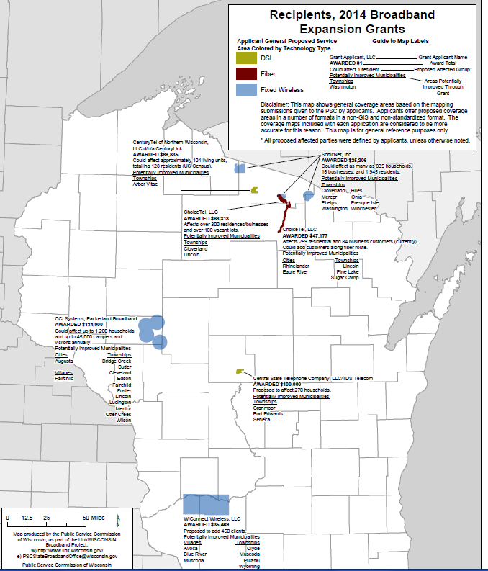
2014 Docket Number :5-GT-100
2015 Docket Number: 5-GF-237
http://psc.wi.gov/apps35/ERF_search/default.aspx (search docket id)

Slide 32
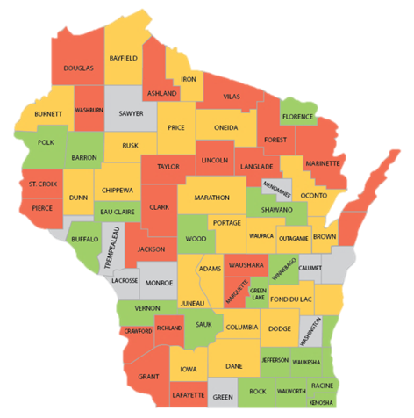
Broadband Adoption (Residential Demand St. Croix)
Unmet Demand
Low
Moderate
High
Inadequate # of Survey Responses
2013 PSC Demand Survey Data (Residential): 64% of respondents indicate a high unmet demand for broadband

Slide 33
Low Network Adoption and Utilization Harms ROI
When end-users don’t see the value of broadband,
providers see slower adoption of broadband
Why would you need a Porsche
to cruise the driveway and get the mail?
The real question is HOW to make broadband
relevant to end-users and improve network performance?
Notes:
Bottom line - to see the economic impact, adoption and utilization are keys. This can be said for small businesses as much as it can be said for households.

Slide 34
Broadband Adoption (Subscribership)
Percent in Census Tracts Where At Least 20% Subscribe to a 3 Mbps or Greater Down Speed
COUNTY | Total Population | Number in Subscribing Census Blocks | Percent in Subscribing Census Tracts
ST. CROIX | 84345 | 55617 | 65.94%
DUNN | 43857 | 35241 | 80.35%
PEPIN | 7469 | 0 | 0.00%
POLK | 44205 | 30317 | 68.58%
PIERCE | 41019 | 37321 | 90.98%
Source: FCC-477, 2013
Notes:
The percent of population in each county identified as living in a Census Tract where at least 20% of population subscribe to a fixed broadband service advertised at 3 Mbps download speed or greater, June 2013.
This is not comparable to an estimate of the number of people in a county that subscribe to a broadband service. For example, in a county where there is 100% that live in Census Tracts where there is substantial broadband subscription, it does not follow that everyone in that county subscribes. However, it is a useful data point to compare a county's subscription relative to peer counties. The data is available for ranges at a census tract level.

Slide 35
Broadband Utilization
Bandwidth Assessment Tool
SNG Group/E-Commerce Data
Community Assessments, Case Studies, Anecdotal Stories

Slide 36
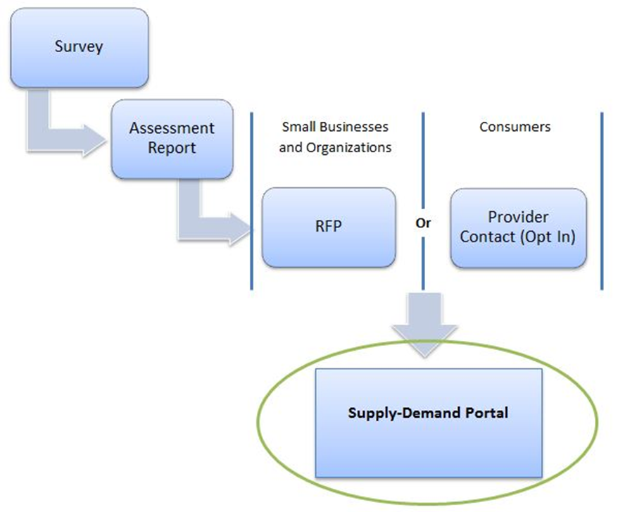
Bandwidth Assessment Tool (BAT)

Slide 37
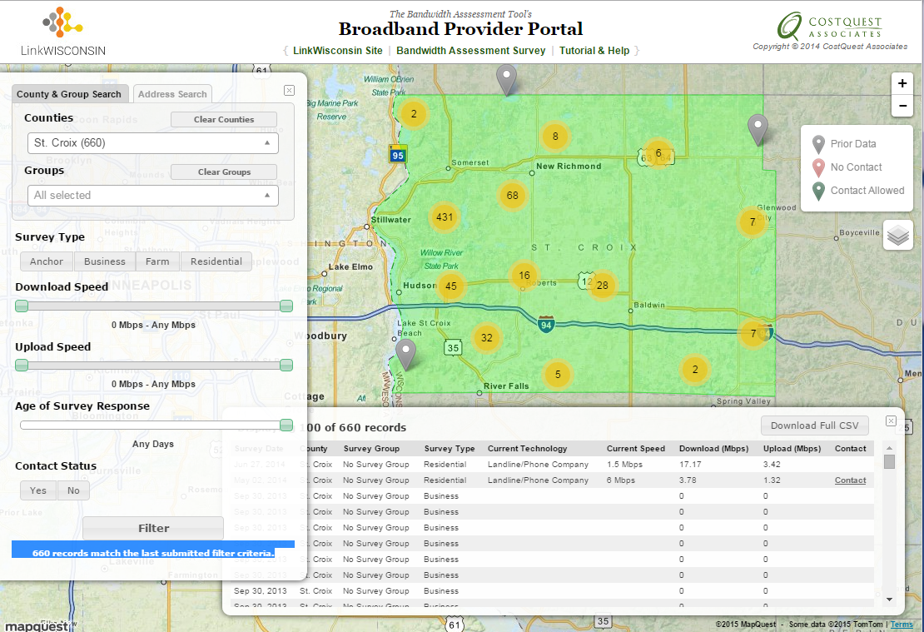
Business & Residential Data
https://apps.costquest.com/pp/wi

Slide 38
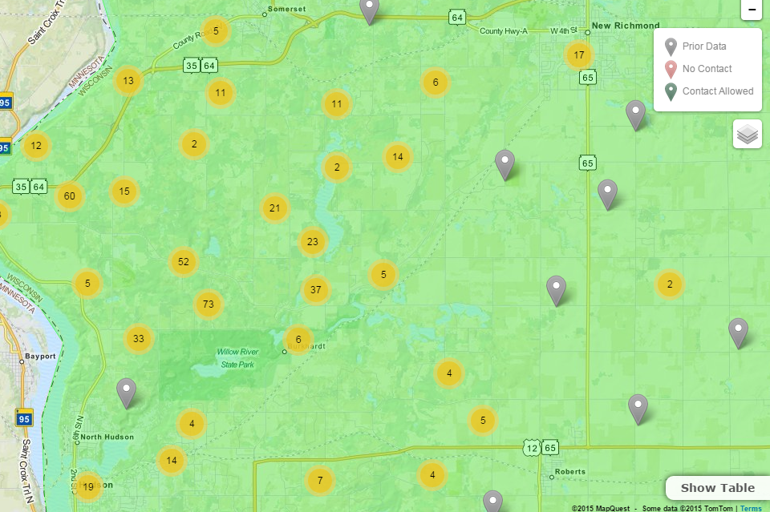
Provider Portal

Slide 39
Business/Residential BAT Data

Slide 40
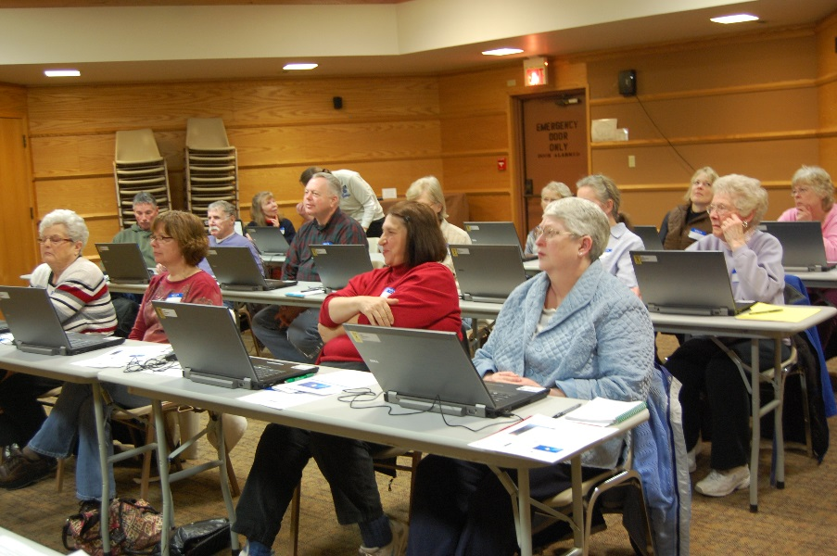
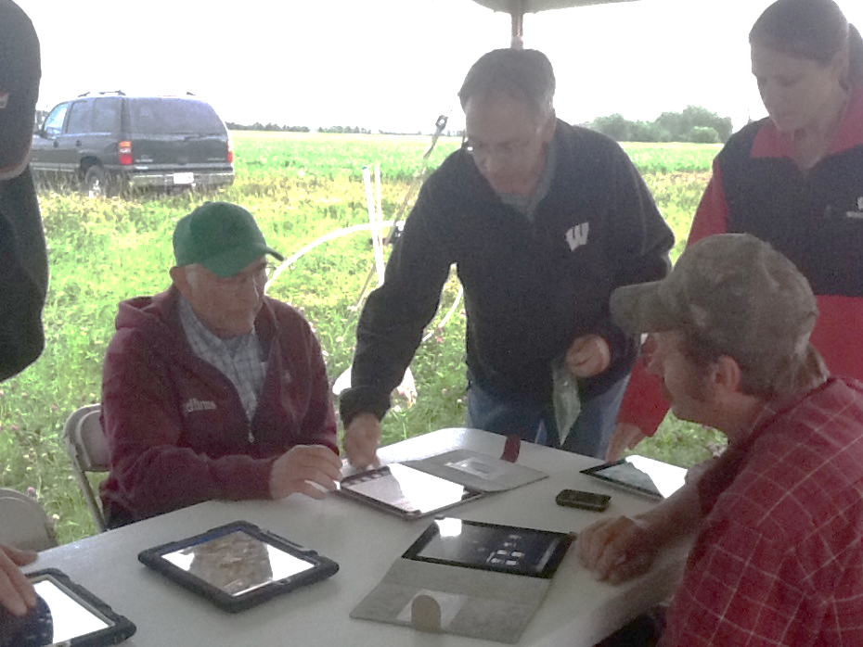
Who are Your (adoption/utilization) partners?
Libraries
Schools
Community Centers
Senior Centers
Providers
Other?

Slide 41
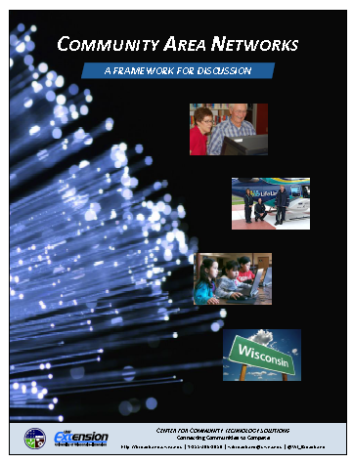
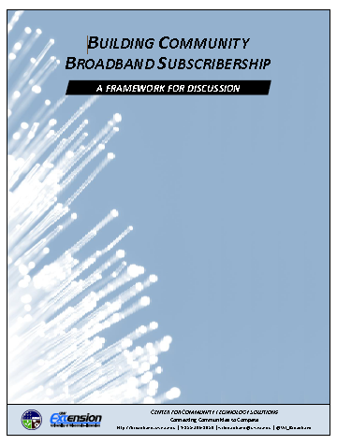
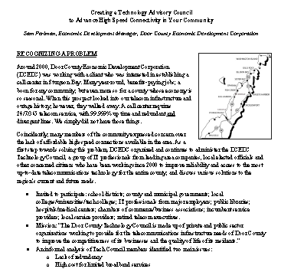
Resources to Get Started
Reference Materials
Wisconsin’s Broadband Reference Guide
Broadband Funding
Policies and Regulations
Creating a Technology Council
Building a Community Area Network
Building Subscribership
Videos and Case Studies
Business and Rural E-Commerce
Telestroke/Telemedicine
K-12 Education
Broadband in Rural Wisconsin
Broadband on the Menomonie Nation
Community Area Networks
High-speed Bits
Broadband Boot Camps (Coming up in June 2nd and 3rd
http://broadband.uwex.edu/resources/

Slide 42
Questions?

Slide 44
Broadband and Second Homes
Notes:
While St. Croix County does not have a high percentage of seasonal housing as a whole, so may not be an attractor for providers.

Slide 45
Broadband Community Development Process Adoption, Access or Both?
Awakening
Gather Facts
Community Discussion
Infrastructure & Services Adequate
Infrastructure & Services Inadequate
Users are Tech Savvy
Users Lack Sophistication
Determine Community Need
Building Public-Private Partnerships: What’s Your Plan?
Source: Blandin Foundation

Slide 46
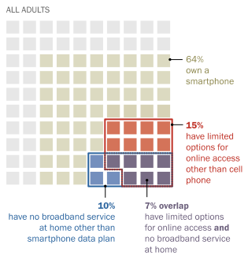
Smart-phone Dependent Population
http://www.pewinternet.org/2015/04/01/u-s-smartphone-use-in-2015/pi_2015-04-01_smartphones_01/

